Slide 1
EPQ Presentation
An artefact, detailing the creation of an AI Maze Solver
By Oskar Czyz

Slide 2
Why did I choose this project?
I chose this project for these reasons:
AI is extremely relevant in recent times due to the introduction of LLMs such as ChatGBT and Gemini.
I was inspired by a Youtube video where someone used reinforcement learning to train an AI to walk.
I enjoy programming and thought this would be a huge learning experience.
A project like this would strengthen my university application.

Slide 3
Project Aims
Here were my project aims (from a programmatic perspective) in chronological order:
Use Breadth-first Search and Prim’s algorithm to randomly generate a maze.
Create a Dijkstra’s algorithm to algorithmically solve the maze.
Create the AI with maze solving capabilities using tabular Q-function reinforcement learning.
Use python libraries to make a nice final visualization of the project.
For my presentation, due to time constraints, I will only be demonstrating the programs highlighted in bold.

Slide 4
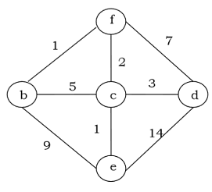
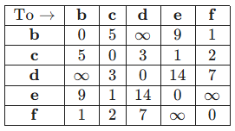
Crash course into graph theory
Forget the standard cartesian (X-Y) graphs that you know as this is completely different. A graph is now a set of points called nodes connected together by lines known as arcs/edges. A network is a graph that has weights on the edges. Every graph can be represented using an adjacency matrix which is effectively just a table. Here is an example of a network and its adjacency matrix:
As you may have noticed, graphs are strikingly similar to mazes and all my ‘mazes’ are effectively just networks.

Slide 5
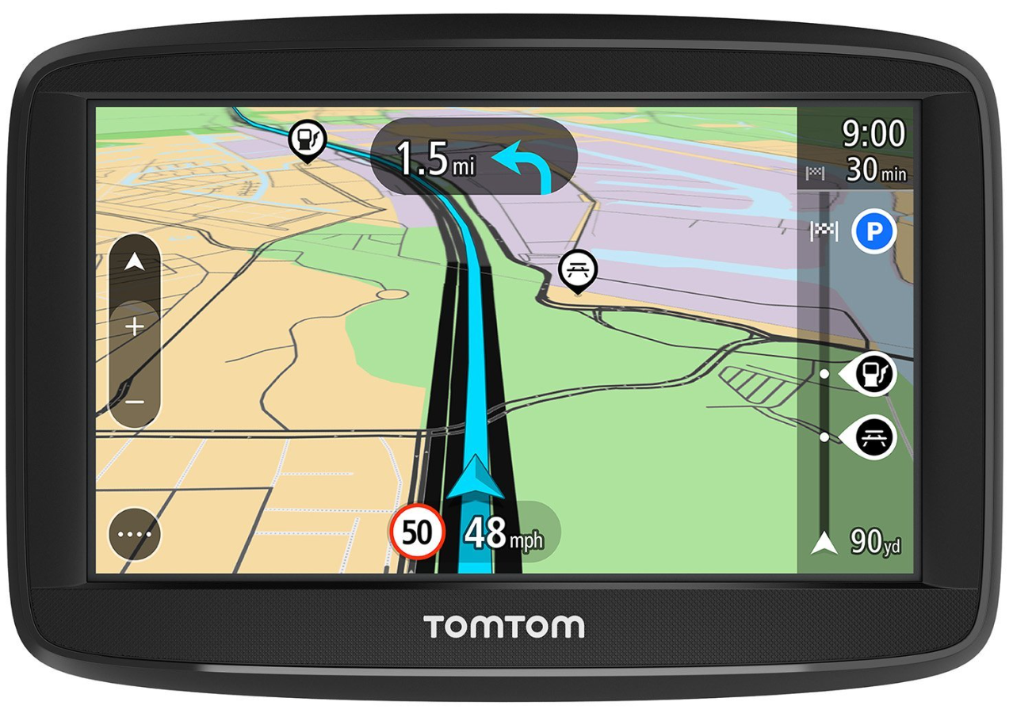
Has anyone ever used a Sat Nav?
If yes have you ever wondered how a Sat Nav works?

Slide 6
Dijkstra’s Algorithm
Sat Navs such as google maps use live road data such as: speed limit; road capacity; traffic data/accidents to construct a network. Sat Navs then use a heuristic algorithm called the A* algorithm to find one of the shortest paths to the end point. The A* algorithm is based entirely on the Dijkstra’s algorithm, however we don’t use Dijkstra’s algorithm because it has a time complexity of O(n²). This basically means Dijkstra’s algorithm get’s very slow for incredibly large networks. Here is a nice visualisation of the algorithms:
https://www.youtube.com/watch?v=BR4_SrTWbMw
(0:13 - Dijkstra’s; 0:50 - A* algorithm)
But how does this algorithm work?

Slide 7
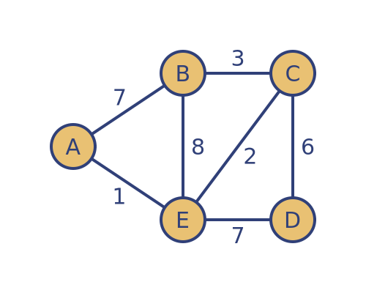
Dijkstra’s algorithm
Can anyone here spot the shortest path from A to D and its length?

Slide 8

Dijkstra’s algorithm
7
1
0
0
1

Slide 9
Dijkstra’s algorithm
7
3
1
0
0
8
2
1
1

Slide 10
Dijkstra’s algorithm
3
3
7/6
3
1
0
0
8
2
1
1

Slide 11
Dijkstra’s algorithm
4
6
3
3
7/6
3
1
0
0
8
2
1
1

Slide 12
Dijkstra’s algorithm
4
6
3
3
7/6
3
1
0
0
From working through the algorithm we can see the shortest path is AED with a length of 8.
5
8
8
2
1
1

Slide 13
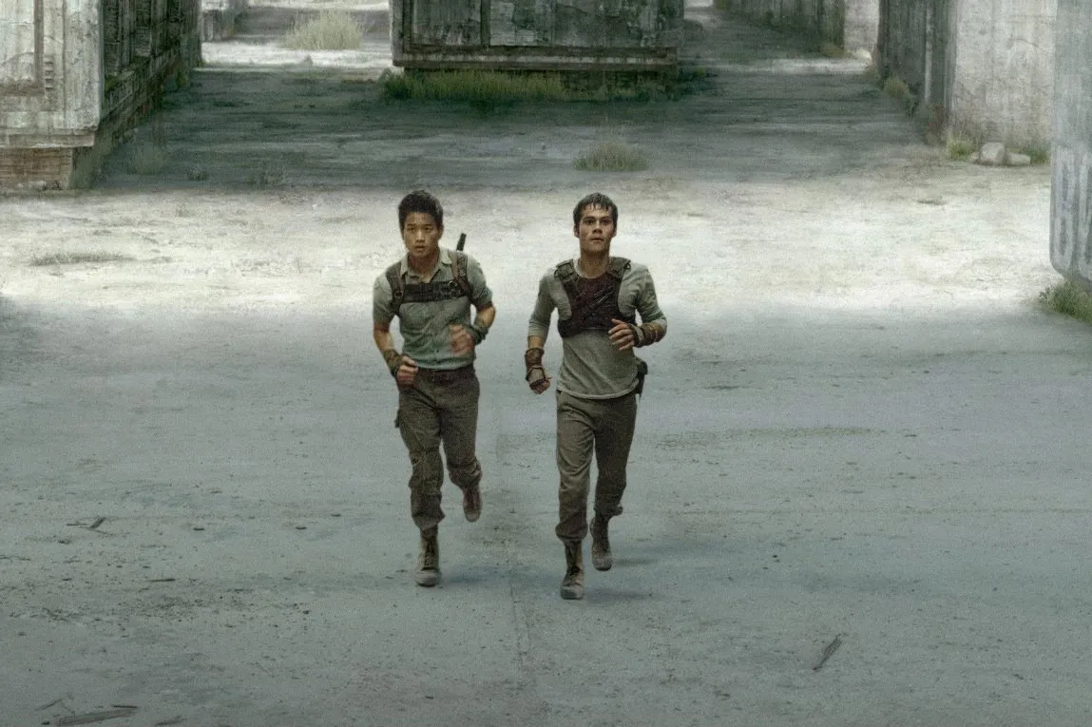
AI Reinforcement learning
Before actually discussing the AI aspect of this, it is nice to visualise what is actually happening. Effectively what I am doing in this program is I am sending out a ‘maze runner’ to travel through one maze thousand of times. On their first run through their maze, they know nothing about the structure of the maze and will be running around randomly until they eventually find the exit. However, after each run in the maze the ‘maze runner’ will begin to remember certain parts of the maze and which routes are better and which are worse.

Slide 14
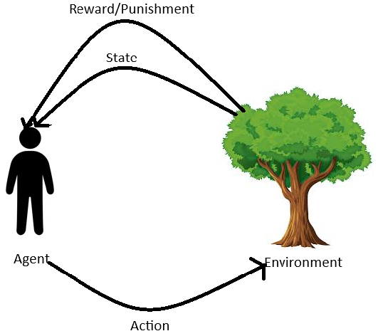
AI Reinforcement learning
The general cycle of reinforcement learning is:
In our case the Agent is the ‘Maze Runner’ and the Environment is the maze.

Slide 15
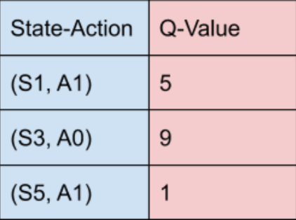
AI Reinforcement learning
The AI makes its decision on what action to choose using a Q-Function. The function takes 2 parameters, the current state and a proposed action, and outputs a number. This number represents the maximum future reward the AI can achieve until the end state. The AI chooses the action with the highest Q-Function value. The syntax for this would be Q(s,a) = 10.
This number is returned from a table of state,action,q-value columns.

Slide 16

AI Reinforcement learning
So we now have some magical table with appropriate Q-Values that would represent better or worse actions but how does this table actually gain this information? We use the Bellman equation during the training process.
The equation shown above is the true Bellman equation but for ease of simplification, the equation can largely be reduced down to:

Slide 17
AI Reinforcement learning
I have copied the simplified Bellman Equation from the previous slide.
When an AI performs a singular step in one run of the maze, the table is updated using the equation. The Q-Value of the action chosen is set to the immediate reward (or punishment) of taking that action plus the discounted maximum possible Q-Value of the next state. The reason why there is a discount is because future rewards are generally considered less important. Also without the discount factor this would cause all the Q-Values to tend to infinity.

Slide 18
AI Reinforcement learning
The AI explanation provided in the previous slides is a large oversimplification of the process my AI goes through in order to learn how to solve the maze however, hopefully it gives you a rough understanding of how it works. Additional concepts such as:
Epsilon Greedy Policy
Hyperparameters (learning rate/epsilon decay rate)
π(s) policies (fixed/state-dependent)
I have intentionally left out as they are technicalities that would cause confusion and don’t add to the big picture.
I can now demonstrate my program working!

Slide 19
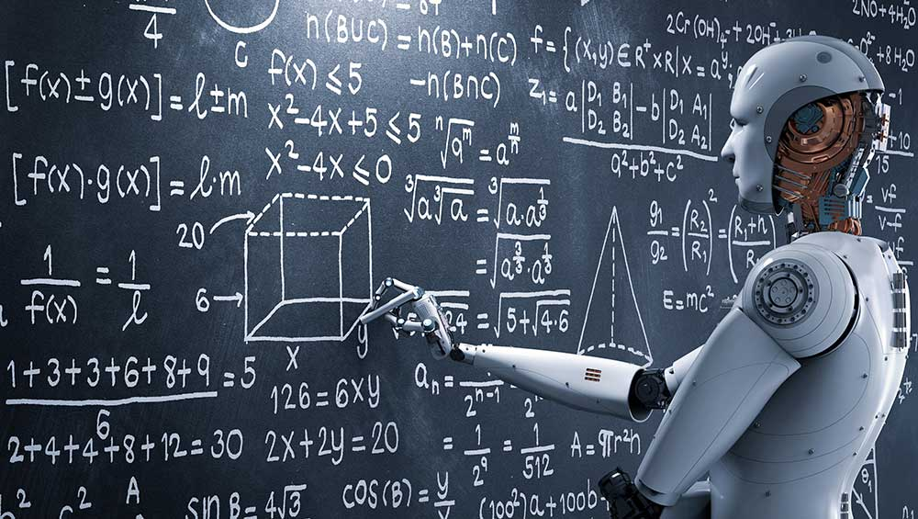
Conclusion
I believe I have achieved the aims that I initially set out to achieve when beginning this project. I now have an AI that can solve a randomly generated maze.
Alongside this I have largely improved my skills in algorithmic design and implementation of external libraries.

Slide 20
Self Reflection
Overall, I enjoyed creating this project, however I did have some difficulties:
Balancing other academics (university applications - TMUA/interview)
Procrastination
Scale issue (choice between Deep-Q neural networks vs Tabular Q-Function)/feature creep
Getting code to run on school PC’s
Actually carrying out the explanation of the code was tedious
Some resources were extremely complicated

Slide 21
Sources used
A level resources (provided by PSC)
Youtube videos
Public programming documentation (matplotlib/networkx)
Websites (Datacamp; Baeldung)

Slide 22
Questions?

